Slide 1
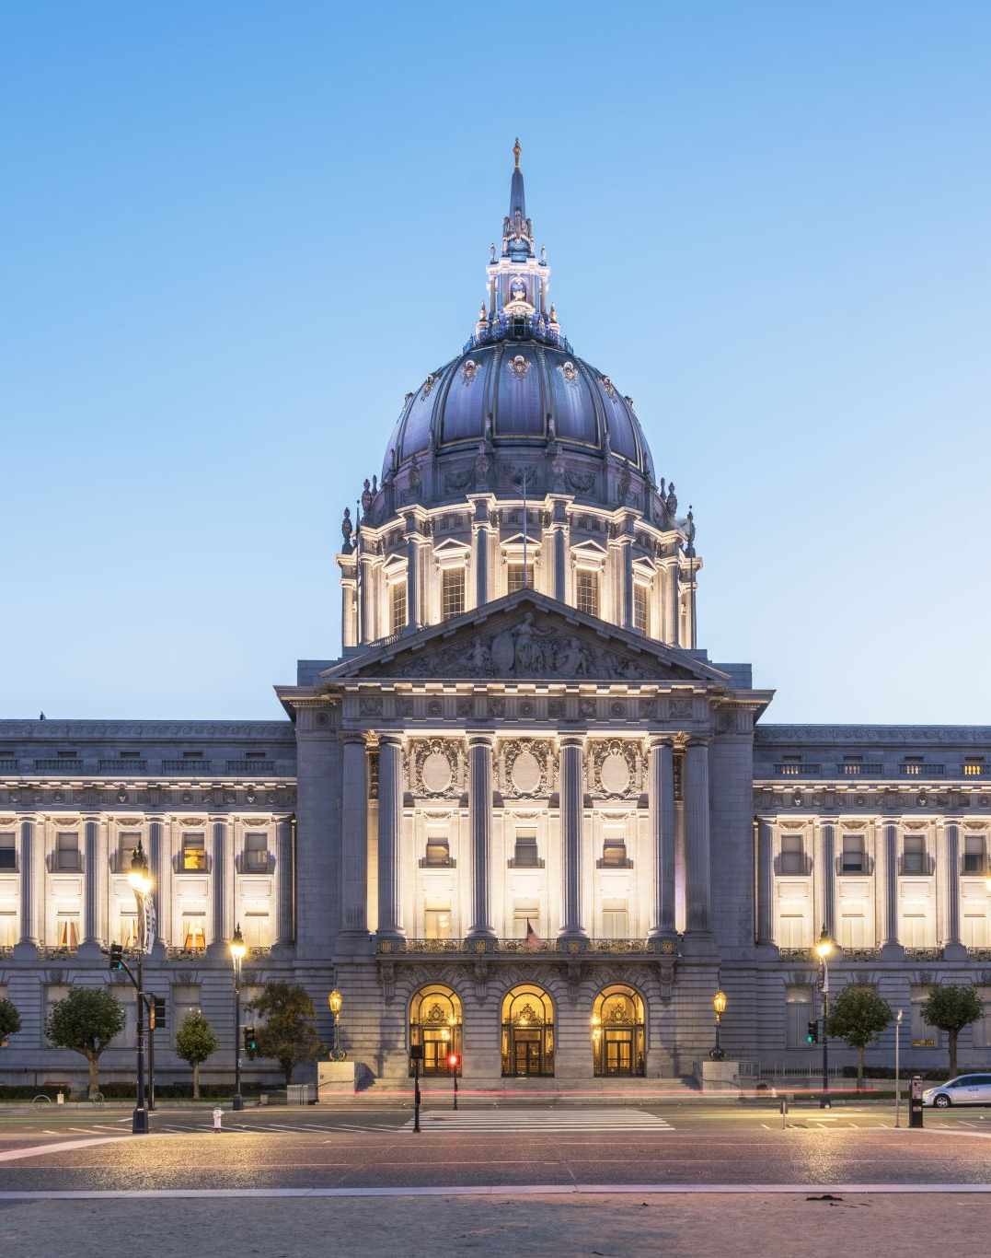
California Recall Prognostication for WAM! News
Wassie, Mekdes
Aziz, Zaid
Morgen, Nadia

Slide 2

WAM! News Political

Slide 3

Problem Statement Californians recently voted decisively not to recall their Governor. Yet many pollsters and pundits predicted a squeaker. An August SurveyUSA poll predicted that 51% of likely voters would vote to recall the Governor. How could they be so wrong?

Slide 4
Problem Statement
Why did the results differ so much from the prognostications?
Is modern polling plagued by the lack of land lines that made random sampling easier?
Did pollsters use the wrong metrics or miss some key metrics?

Slide 5
Goal
At WAM! News, we are trying to develop a more accurate model than our competitors.
Looking at 538’s approach and Gustavo Caffaro’s neural net approach as starting points
Both predicted 2016 presidential better than most

Slide 6
Goal Metrics
Maximize:
Accuracy
Specificity
Recall
Outperform our competitors… WAM!

Slide 7
Data
Cooperative Election Study (CES), fka Cooperative Congressional Election Study (CCES)
National & state polling data 2006-2020
Harvard University, School of Government

Slide 8
Data Methodology
Random telephone polling
Volunteer pool to help balance underrepresented demographics
Weights to finish matching the sample to the adult population of California
* Note: Hispanics likely under-sampled, per study authors

Slide 9
Sample Sizes
Year | 2016 | 2018 | 2020
 | 6,021 | 5,284 | 5,028
All respondents were likely voters in residing in California in the respective years.

Slide 10
Variables
Var Name | Type | Name | Type
Age | Float | News interest | Likert
Approve Gov | Likert | Race | Categorical
Education | Categorical | Voted_gov | Categorical
Family income | Categorical | Voter Reg Status | Validated reg status
Gender | Categorical | Party Reg | Categorical
Ideology | Categorical
Marital Status | Categorical

Slide 11
EDA – Trends: 2016 - 2020
Median age decreased from 47 to 45
Percentage of whites decreased from 55.7% to 52.9%
Percentage of married respondents decreased by 8%
Percentage of never married respondents increased by 5%
Notes:
Small differences matter! We have a good sample size, but it’s still much smaller than the population of CA.

Slide 12
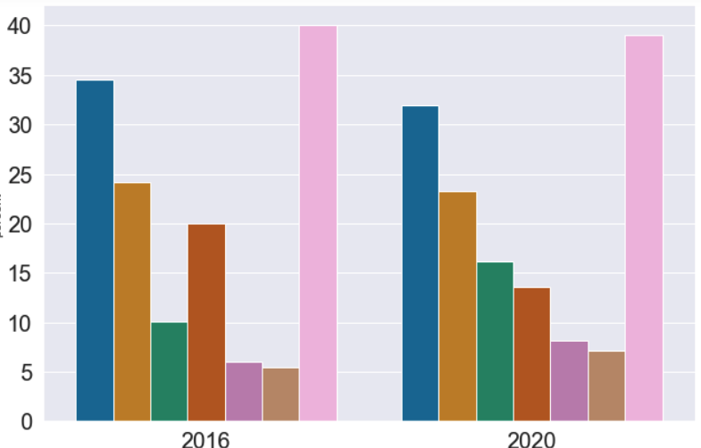
Political Ideology 2016 - 2020
Percent
Moderates + Unsure
Moderates
Moderates
Moderates + Unsure
Conservative
Conservtv.
Liberal
V. Lib
V. Lib
V Con
Liberal
V Con
NS
NS
Notes:
Small differences matter! We have a good sample size, but it’s still much smaller than the population of CA.

Slide 13
Our Methodology
All Classification models, since recall election was binary
Logistic Regression
Multinomial Naïve Bayes
Random Forest
Extra Trees
Neural Network

Slide 14
Null Model
Target: ”Who did you vote for?” – 2018
Target Data: 62% Positive / 38% Negative
Null Model: 62% Accuracy

Slide 15
Our Methodology
Best Models:
Voting Classifier
Random Forest
Neural Network

Slide 16

Voting Classifier
Ensemble Learning:
Logistic Regressor
KNN Classifier
Multinomial Naïve Bayes
We wanted our models to be interpretable

Slide 17
Voting Classifier
Metrics | KNN Class. | MN NB. | Logs Reg. | Vote Class.
Accuracy | 81% | 92% | 92% | 93%
Sensitivity | 90% | 94% | 95% | 96%
Specificity | 65% | 88% | 88% | 88%
Precision | 81% | 93% | 93% | 93%

Slide 18
Voting Classifier
Coefficient |  | Percent Odds
Liberal |  | .943
Strongly App Gov |  | .854
Very Liberal |  | .760
Black |  | .197
Own Home? |  | .148
Coefficient |  | Percent Odds
Strongly Disapp Gov |  | -0.752
Pid3 repub |  | -0.673
Very Conservative |  | -0.320
Pid3 Independent |  | -0.250
Disapprove or Somewhat Dis Governor |  | -0.21

Slide 19
Voting Classifier
Interpretation:
Misclassifications
Inference Information
Try Random Forest

Slide 20
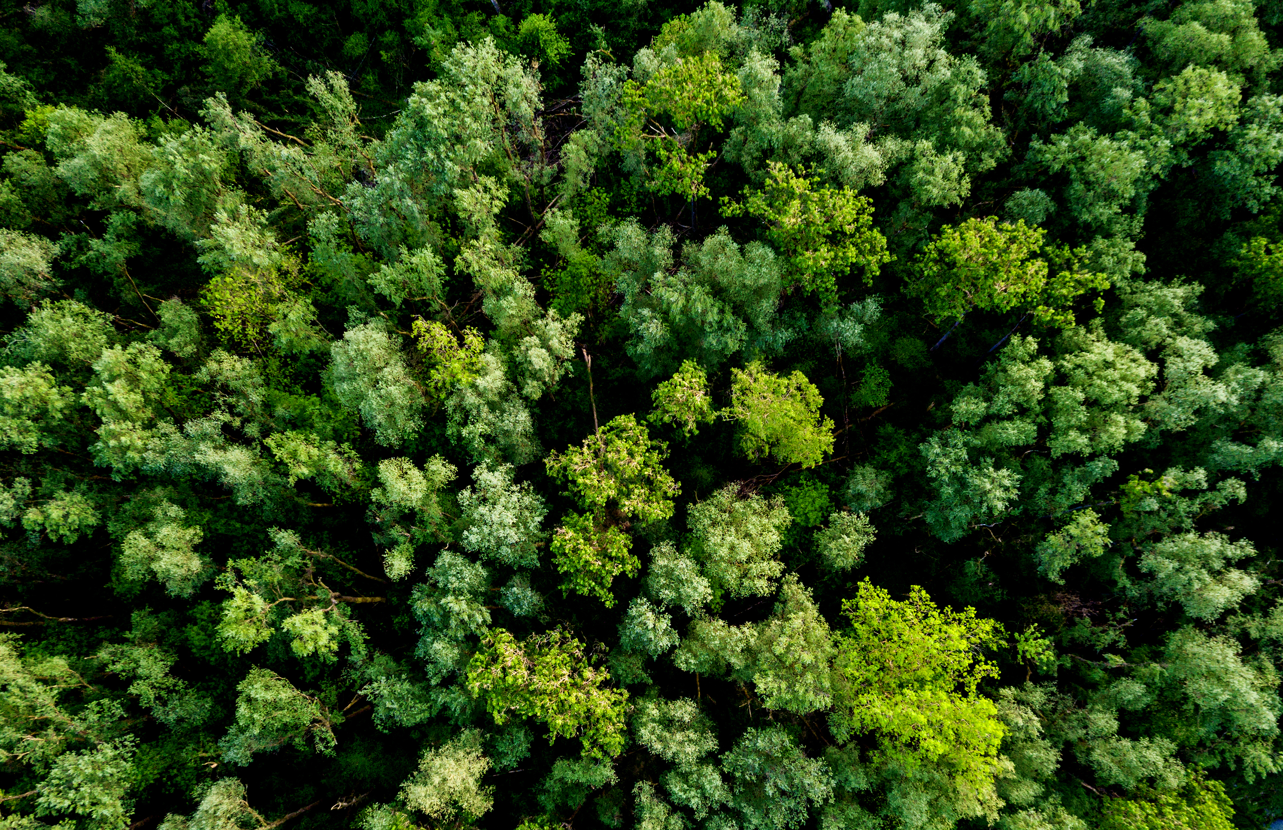
Random Forest
Metric | Model 1 (%) | Model 2(%)
Accuracy – Train | 100 | 93
Accuracy – Test | 93.5 | 93
Specificity | 88 | 89
Recall | 97 | 96

Slide 21
Neural Net
Metric | Early Stopping | Drop-out | ES & DO
Accuracy – Train | 96 | 97.7 | 96
Accuracy – Test | 93.6 | 92 | 92
Specificity | 94 | 94.6 | 95
Recall | 90 | 88 | 89

Slide 22
Best Model: Random Forest
93% Accuracy
96% Recall
89% Specificity
Bootstrap
Max depth: 6
Max features: 0.5
Number of estimators: 100

Slide 23
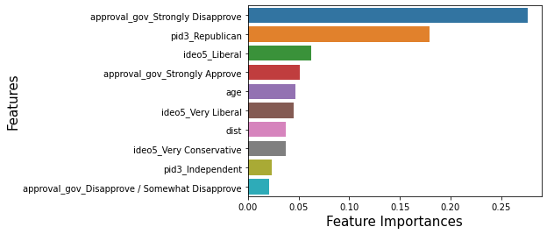
Random Forest: Top Ten Feature Importances

Slide 24
Model Test on Unseen Data
Tested our model on Harvard 2020 data
Average of predicted probabilities
Republicans - 31.3%
Democrats - 68.7%

Slide 25
Conclusions
Model performed well on unseen data
Similar models can be used to predict who someone will vote for
Interpretability adds value to our modeling

Slide 26
Recommendations
Improve accuracy using clustering techniques, and PCA
Model in time series to see how changes to voter demographics change election outcomes

Slide 27

Questions?

